Slide 1
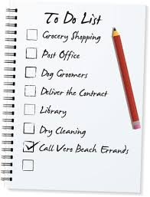
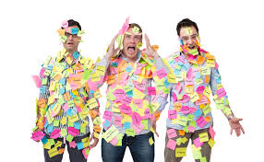
Are you tired of the post-its and to-do lists?
Notes:
Lisa

Slide 2
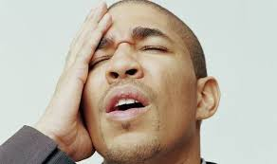
Are you always forgetting something important?
Notes:
Lisa

Slide 3
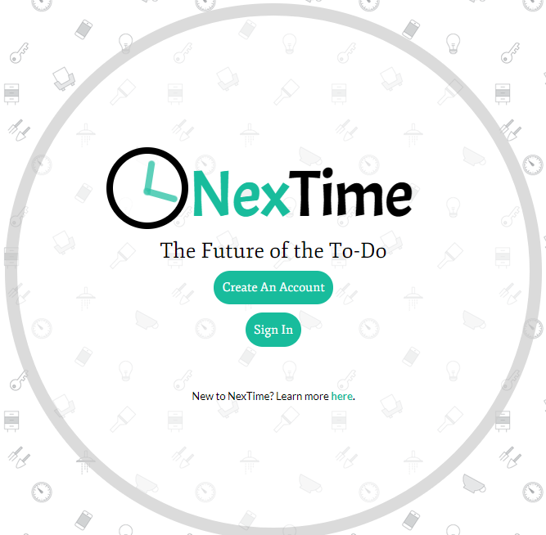
No worries…
There’s always NexTime!
Notes:
Lisa

Slide 4
The Overall Concept
NexTime is a smart to-do list that will revolutionize the way we write and complete to-do lists.
NexTime provides the user with a sleek and user-friendly interface in which the user can compile all tasks.
While the user is on the move, NexTime will periodically identify the user’s location and send an alert when the user is near a place where an item on the to-list can be completed.
It is the perfect tool for anyone who wants to be organized and efficient!
Notes:
Lisa
The future of the to-do list is here! NexTime is a smart to-do list that will revolutionize the way we write and complete to-do lists.
NexTime provides the user with a sleek and user-friendly interface in which the user can compile all tasks. While the user is on the move, NexTime will periodically identify the user’s location and send an alert when the user is within a certain radius of a place where an item on the to-list can be completed.
NexTime’s task list is interactive, providing the user with multiple fields to detail daily tasks and multiple ways in which to view tasks.
It is the perfect tool for anyone who wants to be organized and efficient!

Slide 5
Why NexTime? (The motivation for development)
We have all been there. We arrive home after battling traffic only to realize that we forgot to do something important. The last thing anyone wants to do after a long day is go back out!
NexTime to the rescue!
No more post-its, no more reminder rubber bands, and no more meaningless alerts.
Now there is NexTime!
Notes:
Lisa
We have all been there. We arrive home only to realize that we forgot to stop by the grocery store to buy an ingredient for tonight’s dinner or we forgot to pick up a prescription we need from the pharmacy.
The last thing anyone wants to do after a long day is go back out!
NexTime to the rescue! NexTime will remind you when you of what you need to do at the exact right time – when you are within the vicinity of a place where you can complete your list. No more post-its, no more reminder rubber bands, and no more meaningless alerts.
Now there is NexTime!

Slide 6
Design Process (Getting from an idea to an application) Project Management
Project Manager
User Stories and Issues
Google Hangouts, Github, zoom
Notes:
Janessa
The first part of our design process was to discuss project management
We elected Leaveil as our dedicated Project Manager, and Lisa also assisted in this area
We created user stories through the “issues” section on Github, and mapped out several steps outlining the user experience
We also had daily google hangouts calls that would run in the background while all of us were working, so that if we had questions or needed feedback everyone was already connected and able to quickly view shared screens

Slide 7
Design Process (Getting from an idea to an application) Front End
Create Wireframes, logo, and overall styling concept
Pseudo-code and code basic front-end html skeleton, javascript, and front-end ajax calls
Pseudo-code and code CSS
Pseudo-code and code modal notifications
Notes:
Janessa
In terms of visual design, we started off first by creating hand-drawn wireframes, which were then transferred to digital mockups in sketch
After we had the first mockup completed, we were able to start psuedo-coding and building the basic front-end while still refining the design

Slide 8
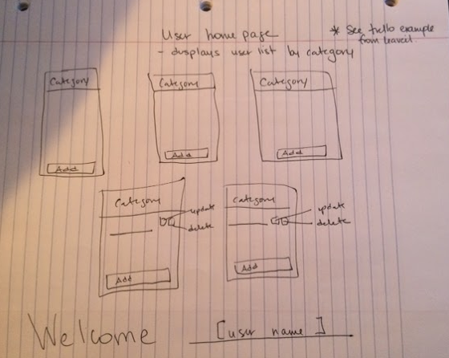
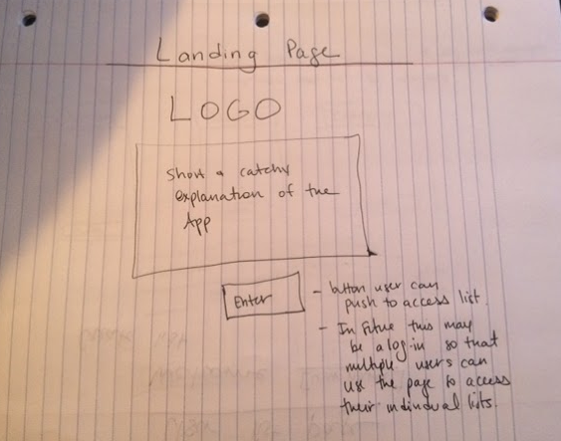
Rough sketch
Notes:
Janessa

Slide 9
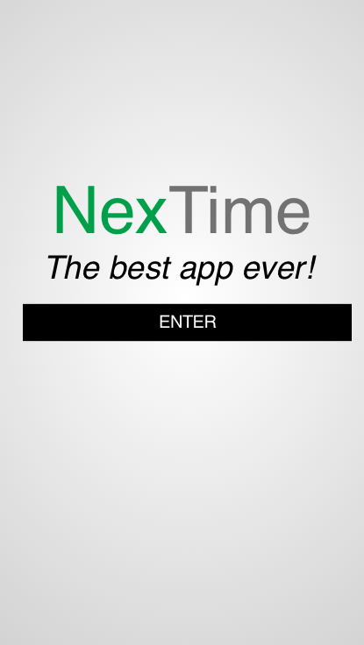
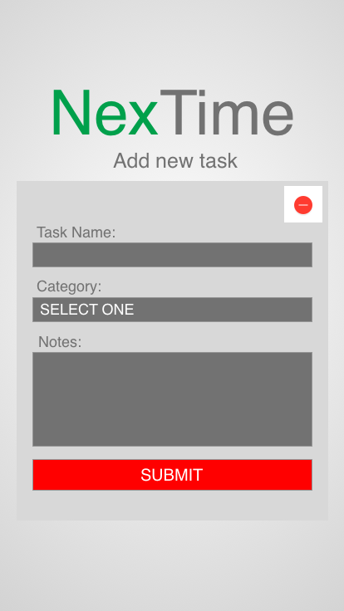
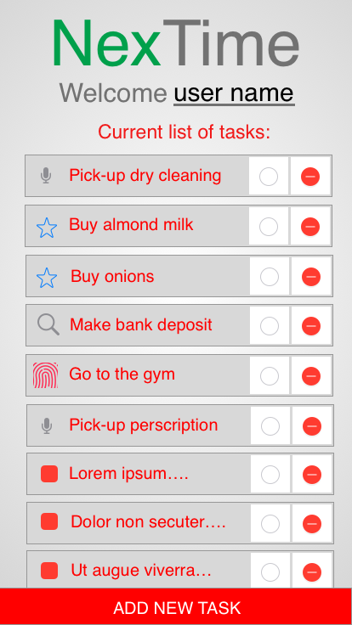
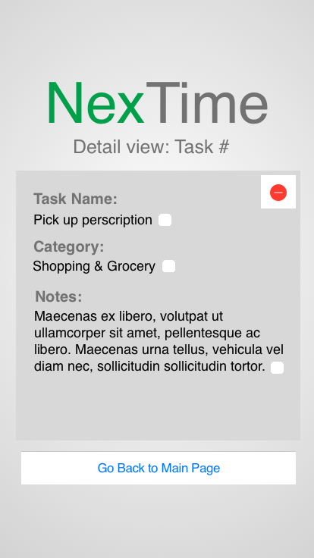
Wireframes
Notes:
Janessa

Slide 10
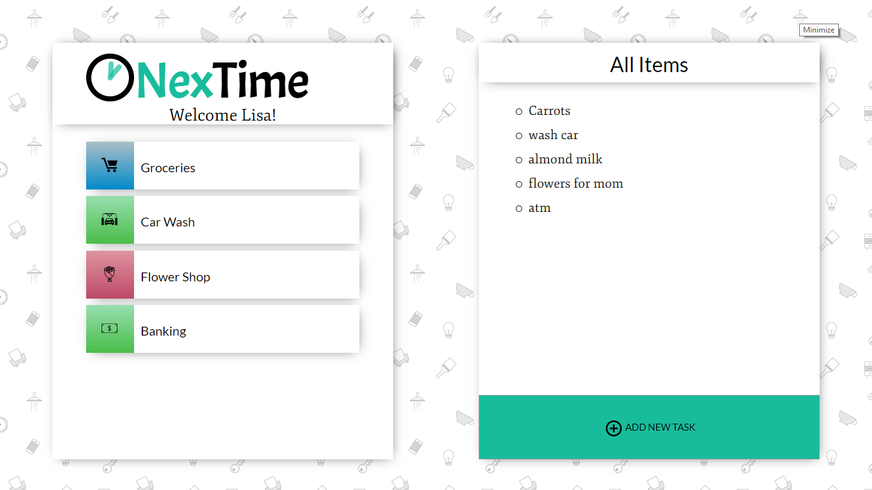
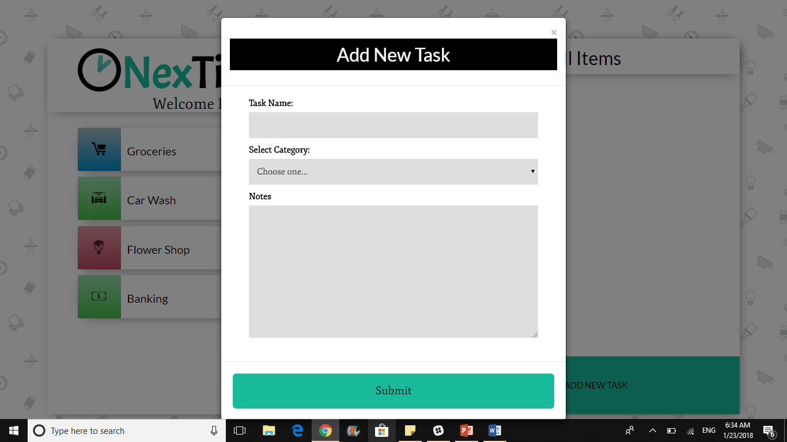
Final Design
Notes:
Janessa

Slide 11

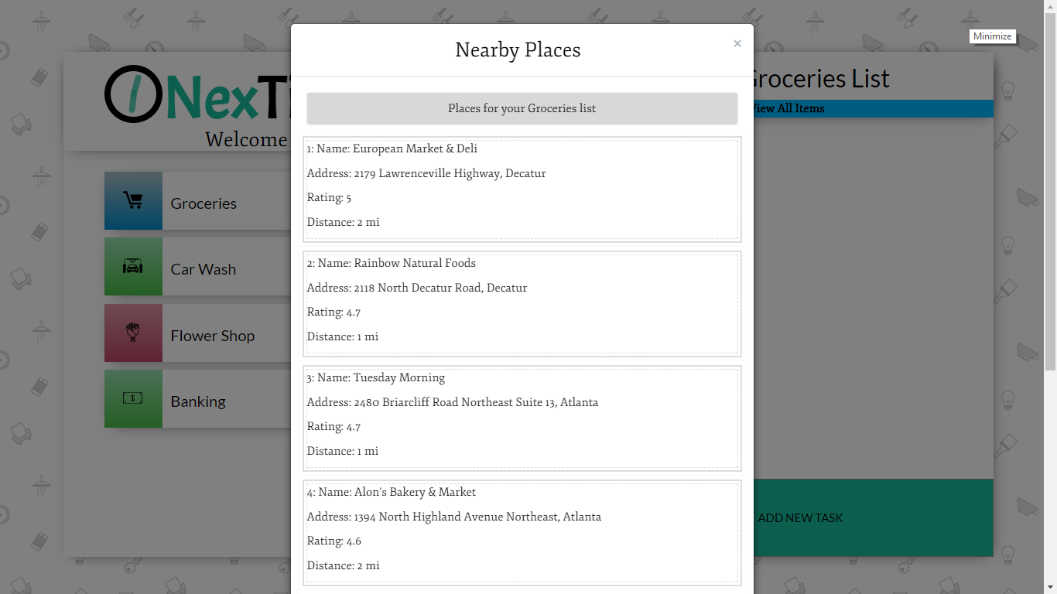
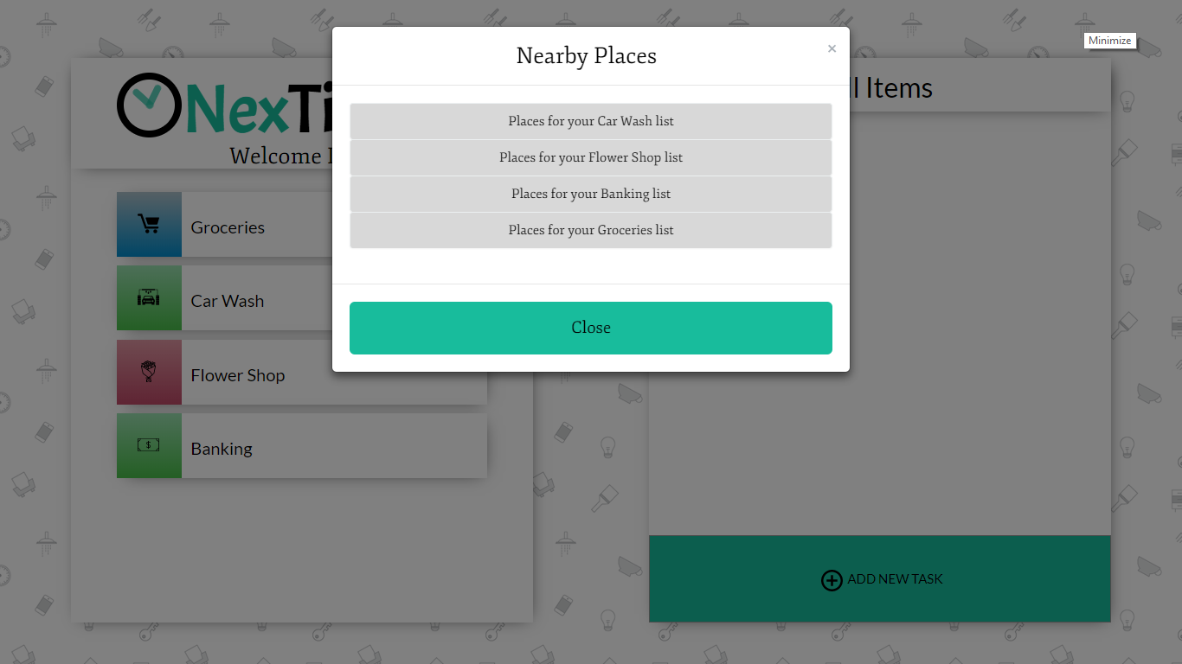
Final Design
Notes:
Janessa

Slide 12
Design Process (Getting from an idea to an application) Back End
Research and perfect tracking technology and google places API
Create MySQL databases
Pseudo-code and code location functions and google API Ajax calls
Pseudo-code and code API routes and HTML routes
Convert to handlebars and connect front end with back end
Notes:
Leaveil and Jay

Slide 13
CRUD
Create: The user can create a user account and a unique to-do list with items that are associated with the user’s Id.
Read: The user has the ability to view all tasks on the to-do list in a variety of formats, including all items, items by category and detailed view.
Update: The user can update an item on the to-do list.
Delete: The user can delete items on the to-do list.
Notes:
Leaveil
Create: The user can create a user account and a unique to-do list with items that are associated with the user’s Id. This process creates entries into a user database and an items database. The application also creates a categories database with preset values.
Read: The user has the ability to view all tasks on the to-do list in a variety of formats, including the complete list with all items, a categorical list with all items in a specific category, a detailed view of a specific item.
Update: The user can update an item on the to-do list.
Delete: The user can delete items on the to-do list.

Slide 14
Tracking, Google Places API, Notification
Employs HTML Geolocation using the .watchPosition method.
Employs a proprietary algorithm to avoid continual alerts when user is stationary.
Connects category information plus location to make a Ajax call to the Google places API.
Return notification with top five options.
Notes:
Leaveil and Jay

Slide 15
Technologies
Google Places API
Handlebars
Node.js
My SQL (nextime database with three tables: users table, categories Table, items Table)
HTML5 Geolocation
Bootstrap
Sequelize
Javascript, HTML, Jquery
CSS animation with keyframes
Sketch (wireframing)
Modals
Express
Deploy to Heroku
Animate.css
Notes:
Janessa

Slide 16
What’s Next for NexTime? (Ideas for future development: The possibilities are endless!)
Notes:
Janessa
User manipulated radius for location notification.
Google Maps integration.
Ability for user to insert specific locations that user would like to visit in the future.
Ability for user to click on a location and add to NexTime list.
Walk Mode and Drive Mode
Expanded selection of categories.
Interface with locations in area to display coupons and compare prices for items on list.
Mobile platform with direct mobile notifications.
Smart technology that makes suggestions based on user preferences determined from user habits.

Slide 17
Questions?

Slide 18
